Slide 1

Analytical CRM Development for Bank
By Sukhendu Senapati

Slide 2

Content
Introduction
Data Exploration
Data cleaning and data preparation
Problem statement
Churn rate trend throughout multiple years
Churn analysis by number of products
Recommendation to increase number of product usage
Churn analysis by age
Recommendation for age related churning
Churning based Credit Card holding
Churning based on credit score class
Dashboard
Conclusion

Slide 3
Introduction
Analytical CRM Development in Banking involves the implementation of advanced analytics and intelligent decision-making tools to enhance customer experiences and drive business growth. This CRM system enables banks to comprehensively analyze customer data, uncover trends, and make informed decisions. By leveraging analytics, banks can segment customers, monitor behaviors, predict patterns, and track changes effectively. The primary goal is to improve customer engagement, satisfaction, and retention by delivering personalized marketing campaigns and offers based on data insights. Analytical CRM plays a critical role in understanding customer behavior, enhancing operational efficiency, and fostering long-term customer relationships in the banking sector.

Slide 4

Data Explanation
CustomerId: A unique identifier assigned to each customer
CreditScore: This numerical value represents a customer’s creditworthiness. The credit scores are categorized as follows:
Excellent: >800, Very Good: 700–800, Good: 600–700, Fair: 500–600, Poor: <500
GeographyID: A numerical identifier corresponding to the customer’s geographical location
GenderID: A numerical code representing the customer's gender (e.g., '1' for male and '2' for female)
Age: The age of the customer
Tenure: The number of years the customer has been with the bank
Balance: The current balance in the customer’s account.
NumOfProducts: The number of products a customer has purchased through the bank
HasCrCard: Indicates whether a customer has a credit card (1 for yes, 0 for no)
IsActiveMember: Identifies if a customer is active (1 for active, 0 for inactive)
Estimated Salary: The estimated salary of the customer
Exited: Indicates if the customer left the bank (1 for exited, 0 for retained)
Bank DOJ: The date when the customer joined the bank

Slide 5
Data cleaning and data preperation
Type of `Bank DOJ` column is text & it is in ‘DD-MM-YYYY’ format. To change it to date format I add a new column called `Bank_DOJ_UPDATED`.
Cleaned special characters from genderID column
Identified data discrepancy in ActiveMember column

Slide 6
Problem Statement
Customer churn, the rate at which customers stop using a company's products or services, is a key performance metric for banks.
It has a direct effect on both revenue and profitability.
In this presentation, we will examine our bank’s churn rates, focusing on factors such as gender, recent years, credit card ownership, number of products used, credit score categories, and geographical regions.
Our objective is to identify the key drivers of churn and recommend strategies to enhance customer retention and satisfaction.

Slide 7
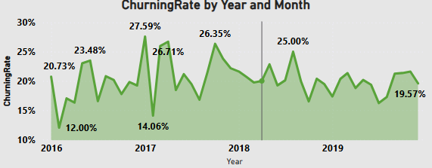
Churn Rate trend throughout multiple years
Churning rate trended down, resulting in 5.58% decrease between Jan 2016 and December 2019.
Though churning rate trended up in 2017 & 2018
In 2017 churning rate reached highest point of 27.59%

Slide 8
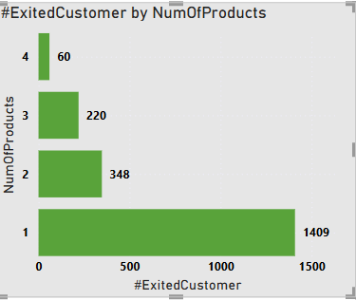
Churn Analysis by Number of Products
Chart illustrates churned customers by number of products used.
Customers who have used only one product are responsible for maximum churning.
Minimum churning shown in customers who are using all 4 products.
Form the chart I can say that when a greater number of products are used by customers churning rate reduced. Multiple product users find more value in their relationship with the bank. To reduce churning rate customers should be pushed to use multiple products.

Slide 9
Recommendation to increase no. of product usage
Targeted Product Bundles: Develop tailored bundles for specific customer segments to highlight added benefits and cost savings
Promote products: Promote the benefits of using various banking products. Make customers understand the value of using multiple products.
Targeted Campaigns: Try to understand spending habit of single product using customers .
Target these customers with personalized offer. Use advanced analytics to provide these customers with personalized offer.

Slide 10
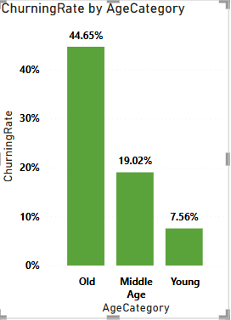
Churn Analysis by Age
Among old customers churning rate is maximum
Among Middle aged customers churning rate is lower than that of old customers but higher than young customers.
Among Young customers churning rate is minimum

Slide 11

Recommendation for age related churning
Personalized Offers and Services:
Develop highly personalized product bundles that meet the unique needs of each customer segment. For instance, offer first-time home buyers packages that combine mortgage services with homeowner insurance and financial planning tools. For affluent customers, design premium bundles that include investment management and wealth advisory services.
Provide exclusive discounts or financial incentives for customers who purchase multiple products, such as a reduced interest rate on loans for clients who hold both checking and savings accounts.
Targeted Marketing and Communication:
Design marketing campaigns tailored to the specific financial needs and goals of different age groups. For instance, younger customers might benefit from campaigns focused on saving plans, while middle-aged clients may be more interested in investment opportunities and mortgage products. For older customers, campaigns could emphasize retirement planning, estate management, and wealth transfer options.
Use data-driven insights to personalize messaging across channels such as email, social media, and direct mail, ensuring each age group receives relevant and timely information that resonates with their current life stage and financial priorities.
Customer Loyalty Programs:
Create loyalty programs that reward long-term customers with special benefits such as reduced fees, interest rate discounts, or access to exclusive financial products. These programs can include tiered rewards based on the length of the customer relationship or the total value of their accounts.
Foster deeper engagement by offering personalized rewards, such as early access to new products or services, or additional rewards for referring new customers.
Enhanced Customer Service:
Improve customer service by offering tailored support to specific segments, such as older clients who may require assistance with digital banking tools. Ensure customer service representatives are trained to address the unique concerns of senior customers, such as managing retirement funds or setting up estate plans.

Slide 12
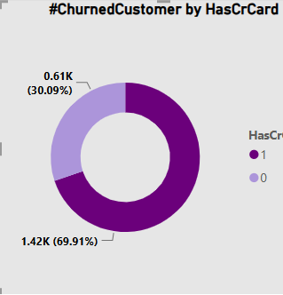
Churning based Credit Card holding
My analysis suggests that among churned customers 69.91% is credit card holder
and 30.09% is noncredit card holder.
From the chart it is clearly visible that holding credit card significantly impact churning.

Slide 13
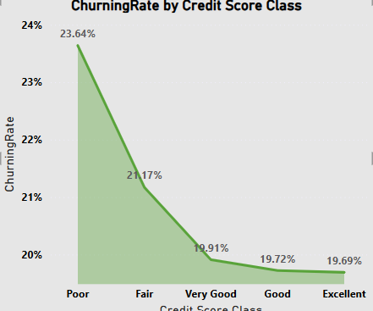
Churning based on credit score class
Insight
From the chart it is clearly visible that customers with poor credit rating has maximum churning rate of 23.64%
Customers with fair credit rating has second highest churning rate of 21.17%
Recommendation
Provide education to customers with poor and fair credit rating on how increase credit rating.
Provide incentive to customers of these segments to reduce churning.
Focus on retention effort for customers with poor and fair credit rating.

Slide 14
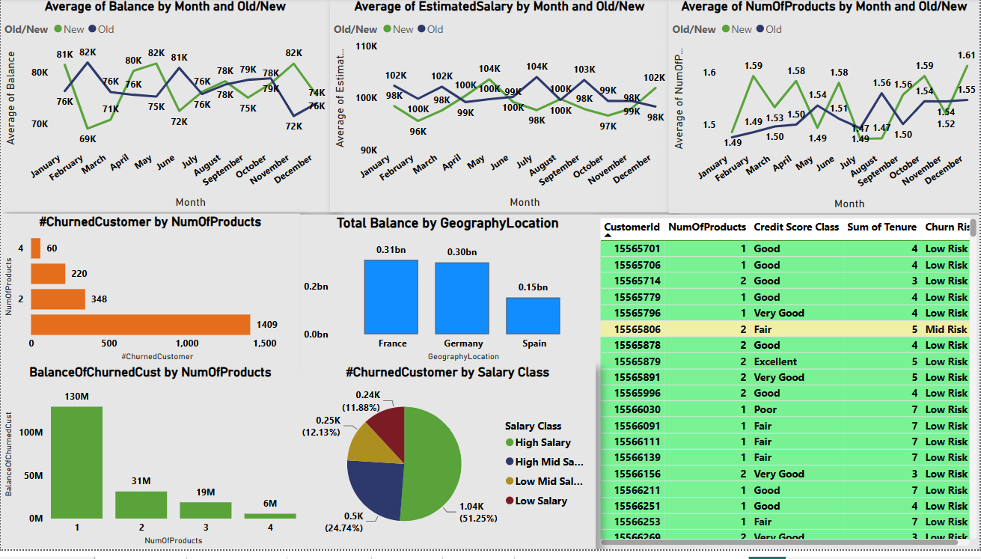
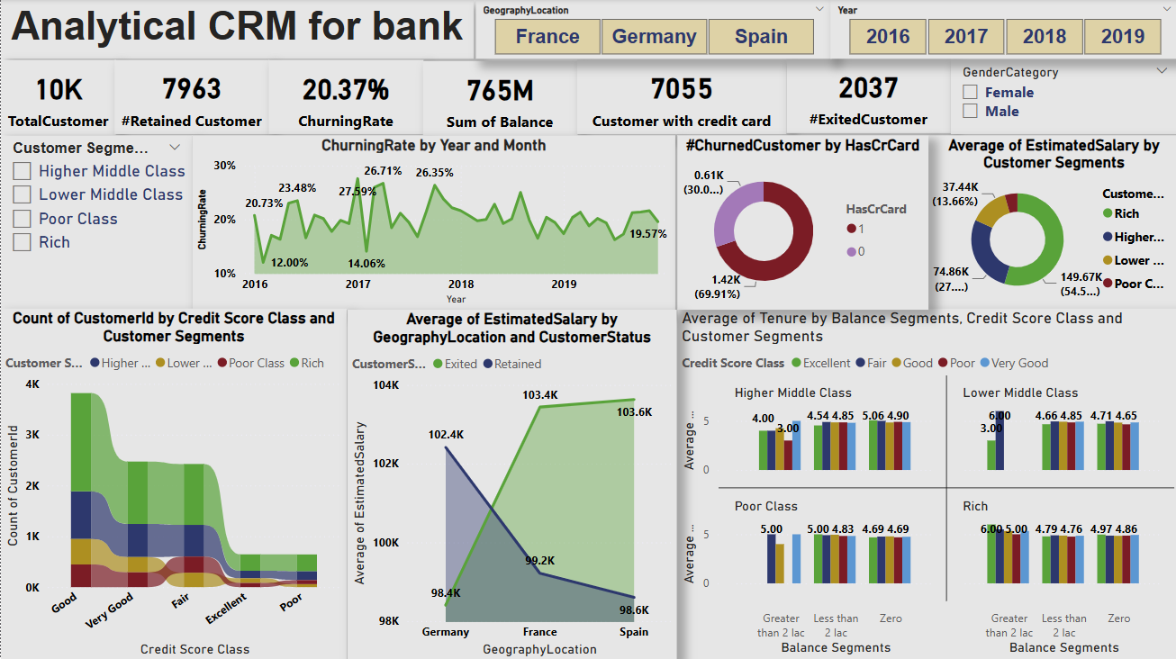
Dashboard

Slide 15
Conclusion
Analysis:
Product Usage and Churn:
Customers using only one product have the highest churn rate.
Churn rate decreases as the number of products used increases.
Multiple product users find more value in their relationship with the bank.
Age and Churn:
Old customers have the highest churn rate.
Middle-aged customers have a lower churn rate than old customers but higher than young customers.
Young customers have the lowest churn rate.
Credit Card Holders and Churn:
69.91% of churned customers are credit card holders.
Holding a credit card significantly impacts churn.
Credit Rating and Churn:
Customers with poor credit ratings have the highest churn rate (23.64%).
Customers with fair credit ratings have the second highest churn rate (21.17%).

Slide 16
Conclusion
Recommendations:
Targeted Product Bundles:
Develop tailored bundles for specific customer segments to highlight added benefits and cost savings.
Promote Products:
Promote the benefits of using various banking products to make customers understand the value of using multiple products.
Targeted Campaigns:
Understand the spending habits of single-product users and target them with personalized offers using advanced analytics.
Personalized Offers and Services:
Develop highly personalized product bundles for different customer segments.
Provide exclusive discounts or financial incentives for customers who purchase multiple products.
Targeted Marketing and Communication:
Design marketing campaigns tailored to the financial needs and goals of different age groups.
Use data-driven insights to personalize messaging across various channels.

